Slide 1
Introduction to Raspberry Pi
Rochester MakerSpace
2019

Slide 2
History
The Raspberry Pi was created in February 2012 by the Raspberry Pi Foundation to promote and teach basic computer science in schools and colleges around the UK.
The Raspberry Pi Foundation is a UK-based charity that works to put the power of computing and digital making into the hands of people all over the world. We do this so that more people are able to harness the power of computing and digital technologies for work, to solve problems that matter to them, and to express themselves creatively.
More than 1M units sold in the first year, more than 4.5M by 2014
Raspberry Pi 4 B went on sale in June 2019, offering faster processor and ports, as well as options for more RAM.

Slide 3
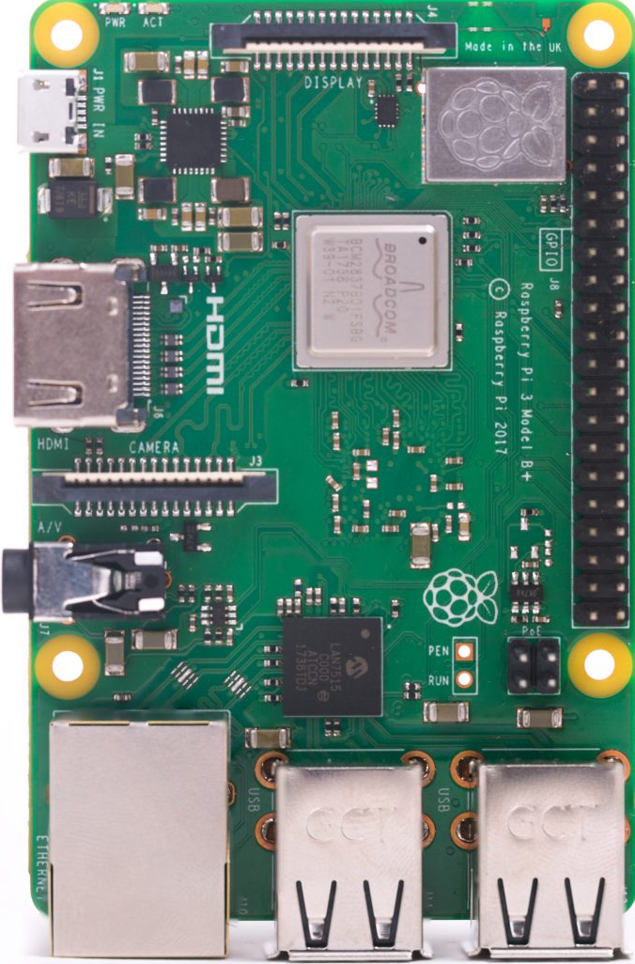
Raspberry Pi 3 B+
Broadcom BCM2837B0, Cortex-A53 (ARMv8) 64-bit SoC @ 1.4GHz
1GB LPDDR2 SDRAM
2.4GHz and 5GHz IEEE 802.11.b/g/n/ac wireless LAN, Bluetooth 4.2, BLE
Gigabit Ethernet over USB 2.0 (maximum throughput 300 Mbps)
Extended 40-pin GPIO header
Full-size HDMI
4 USB 2.0 ports
CSI camera port for connecting a Raspberry Pi camera
DSI display port for connecting a Raspberry Pi touchscreen display
4-pole stereo output and composite video port
Micro SD port for loading operating system and storing data
5V/2.5A DC power input

Slide 4
Raspberry Pi 4 B
Broadcom BCM2711, Quad core Cortex-A72 (ARM v8) 64-bit SoC @ 1.5GHz
1GB, 2GB or 4GB LPDDR4-2400 SDRAM (depending on model)
2.4 GHz and 5.0 GHz IEEE 802.11ac wireless, Bluetooth 5.0, BLE, Gigabit Ethernet
2 USB 3.0 ports; 2 USB 2.0 ports
Raspberry Pi standard 40 pin GPIO header (fully backwards compatible with previous boards)
2 × micro-HDMI ports (up to 4kp60 supported), 2-lane MIPI DSI display port
2-lane MIPI CSI camera port
4-pole stereo audio and composite video port
H.265 (4kp60 decode), H264 (1080p60 decode, 1080p30 encode), OpenGL ES 3.0 graphics
Micro-SD card slot for loading operating system and data storage
5V DC via USB-C connector (minimum 3A*)
5V DC via GPIO header (minimum 3A*)

Slide 5
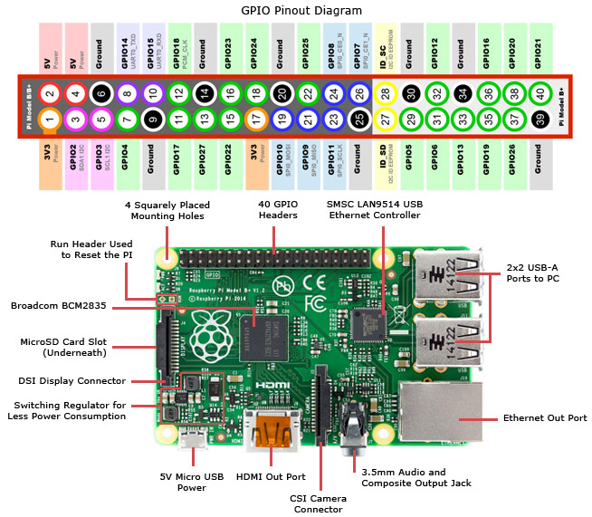
Linux with GPIO!
At 1.4MHz, quad-core and 1GB of RAM, RPi 3 B+ is a capable small Linux system
Raspberry Pi 4 offers a faster processor, two USB 3.0 ports, two (micro) HDMI ports, options of 1GB, 2GB, or 4GB of RAM
Both offer GPIO enabling the creation of different projects e.g., robots

Slide 6
Comparison vs. Arduino
Pros
More RAM + Storage
More processing power
Debug in place
Multiple, concurrent programs
Built-in HDMI and camera interfaces
Built-in WiFi and Bluetooth comms
Built-in Ethernet and 4 USB ports
Pluggable SD card to expand memory
Cons
Non-real-time OS makes real-time programming impractical
Requires some understanding of Linux
Much more configuration required
More electrical power required
No Analog (A/D) inputs
Narrow input voltage tolerance
More expensive
Bottom Line: Choose the right tool for the job

Slide 7
Next Steps
Check out these sources of information
Raspberry Pi Manual
Raspberrypi.org
www.elinux.org
Adafruit.com/category/105 – Raspberry Pi products and accessories
Youtube.com
Design a project or program and get started!
Lots of examples online if you are looking for inspiration

